Slide 1
Production Drawing
A component or part drawing is termed as a production drawing. It is an authorized document to produce the component in the shop floor.

Slide 2
Elements of production drawing
Following are the basic elements of a production drawing.
Format of drawing sheet,
Size and shape of the component,
Projection method,
Material specification and shape such as castings,forgings, plates, rounds, etc.,
Indication of surface roughness and other heat treatments, if any,
Limits, fits and tolerances of size, form, and position,
Production method,
Process sheet,
Specification of standard components,
Conventions used to represent certain machine components, and
Inspection and testing methods.

Slide 3
Drawing Sheet Sizes
There are five standard sizes for drawing sheets (First choice), specified by Bureau of Indian Standards (BIS) SP: 46-1988, as given below.
Drawing sheets may be used with their longer sides positioned horizontally.

Slide 4
Drawing sheet layout

Slide 5
Title block
The drawing sheet layout must also provide a title block, which should be located at the bottom right hand corner of the sheet.
It shouldprovide the following basic information:
1. Title of the drawing,
2. Sheet number,
3. Scale (s),
4. Symbol, denoting the method of projection,
5. Name of the firm, and
6. Initials of the staff designed, drawn, checked and approved.

Slide 6
Title block
A production drawing may include the following additional information, located either in the drawing sheet or in the title block:
1. Job order number,
2. Surface treatment, roughness, etc.,
3. Key to machining and other symbols,
4. A general note on tolerance on dimensions, not individually toleranced,
5. Reference to tools, gauges, jigs and fixtures,
6. Parts list, and
7. Alternations and revisions.

Slide 7
Title block

Slide 8
SHEET NUMBER TITLES
SHEET NO | TITLE
1 | CONVENTIONAL REPRESENTATION OF MATERIALS AND MACHINE COMPONENTS
2 | SYMBOLIC REPRESENTATION OF WELDED JOINTS .
3 | CIRCUIT SYMBOLS FOR ELECTRICAL ITEMS
4 | SYMBOLS FOR HYDRAULIC AND PNEUMATIC DEVICES, NOTES MEANING
5 | Definitions of limits,fits and tolerances.
6 | Problems.
7

Slide 9
CONVENTIONAL REPRESENTATION OF MACHINE COMPONENTS

Slide 10
CONVENTIONAL REPRESENTATION OF MACHINE COMPONENTS

Slide 11
CONVENTIONAL REPRESENTATION OF MACHINE COMPONENTS

Slide 12
CONVENTIONAL REPRESENTATION OF MACHINE COMPONENTS

Slide 13
WELDED JOINT SYMBOLS

Slide 14
WELDED JOINT SYMBOLS

Slide 15
WELDED JOINT SYMBOLS

Slide 16
INTERCHANGEABILITY
The term interchangeability refers to the parts which go into the assembly at random, from a lot.
Eg:- A nut and a bolt of a particular size may be assembled by selecting at random from the lots. In this any nut should be able to get assembled with any bolt.

Slide 17
DEVIATION:-
It means the amount by which the dimension differs (goes away) from zero line.
UPPER DEVIATION:-
The amount by which upper limit deviates from zero line is known as upper deviation. It is designated by letter ES for hole & es for shaft. Where es is E Cart superior.
LOWER DEVIATION:-
The amount by which lower limit deviates from zero line is known as lower deviation. It is designated by letter EI for hole & ei for shaft. EI indicates E cart inferior.

Slide 18
BASIC SIZE or NOMINAL SIZE
It is size of the job which is taken as reference to apply maximum limit and minimum limit for job manufacturing.
ZERO LINE:-
Deviations from basic size are measured with respect to a line called zero line. It represents zero deviation to basic size.
Above zero line +ve deviation.
Below zero line -ve deviation.

Slide 20
ACTUAL SIZE
The dimension obtained by measuring the finished product is known as actual size of the job.
Actual size must lie on or between the upper limit and the lower limit.

Slide 22
FUNDAMENTAL DEVIATION
This may be either upper deviation or lower deviation which is nearer to zero line.
For hole lower deviation is a fundamental deviation.
For shaft upper deviation is a fundamental deviation.

Slide 24
LIMITS, TOLERANCES AND FITS
LIMITS:-
The two extreme permissible sizes between which the actual size is contained are called limits.
Maximum acceptable extreme size is called upper limit. And minimum acceptable extreme size is called lower limit.

Slide 25
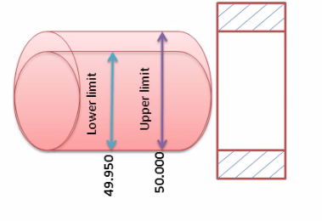
UPPER LIMIT AND LOWER LIMIT

Slide 26
TOLERANCE :-
It is the difference between the maximum and minimum permissible limits of the given size.
Tolerance = upper limit – lower limit.
If the variation is provided on one side of the basic size it is termed as unilateral tolerance. Similarly, if the variation is provided on both sides of the basic size, it is known as bilateral tolerance.
ALLOWANCE :-
It is the internal difference between the hole and shaft dimensions after their assembly is called allowance.

Slide 27
TOLERANCE,UPPER LIMIT AND LOWER LIMIT

Slide 32
FIT
It is the degree of looseness or tightness between two mating parts to perform a definite function.
TYPES OF FITS:-
There are three types of fits
1)Clearance fit
2)Interference Fit
3)Transition Fit

Slide 33
TYPES OF FITS
1)Clearance fit
This fit arises when the diameter of shat is smaller than hole. The minimum diameter of hole is greater than the largest permissible diameter of the shaft. The value of clearance fit is always positive.
2)Interference Fit
In this type of fit the minimum permissible diameter of the shaft is larger than the maximum allowable diameter of the hole. As the diameter of shaft is larger than the diameter of hole, the hole and shaft are intended to be attached permanently.
3)Transition Fit
This fit may result in either interference or a clearance, depending on the actual values of the tolerance of individual parts.

Slide 34
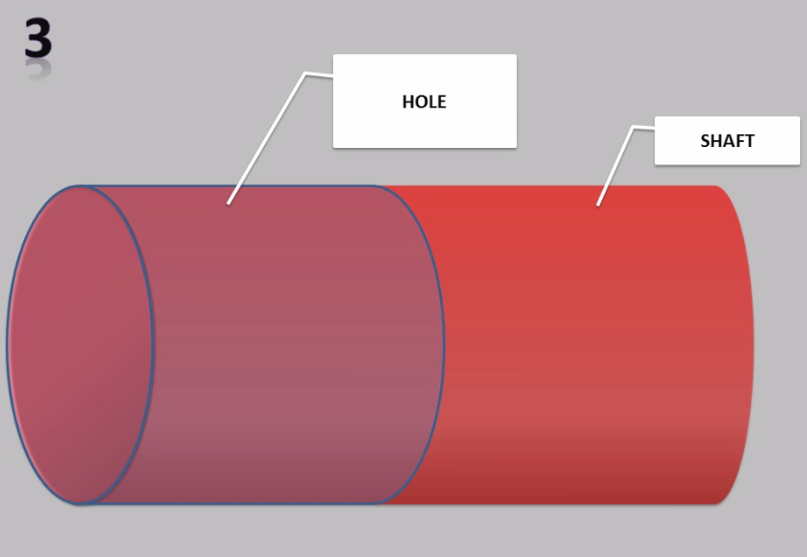

Slide 35
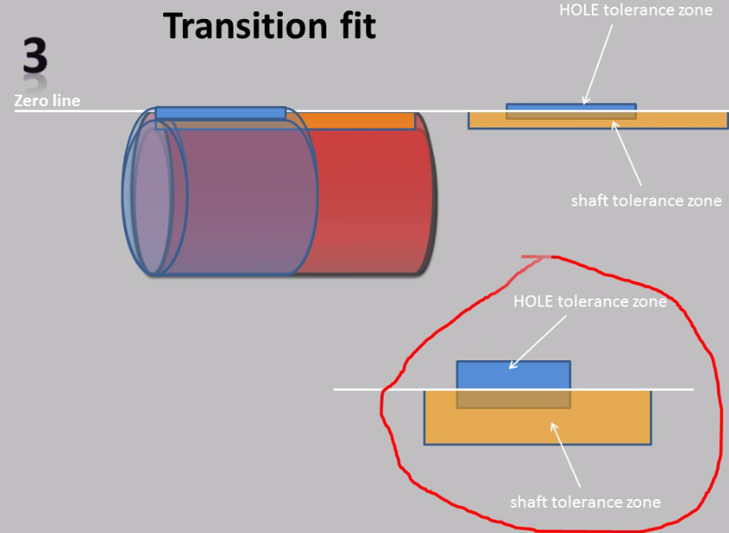

Slide 41
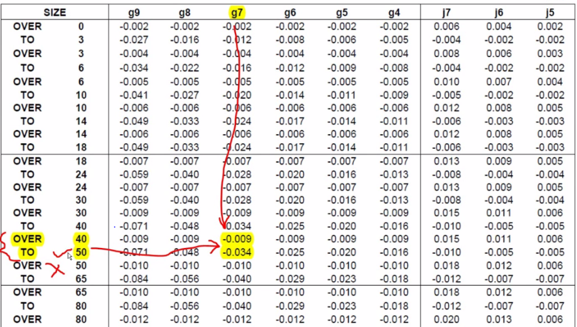

Slide 44
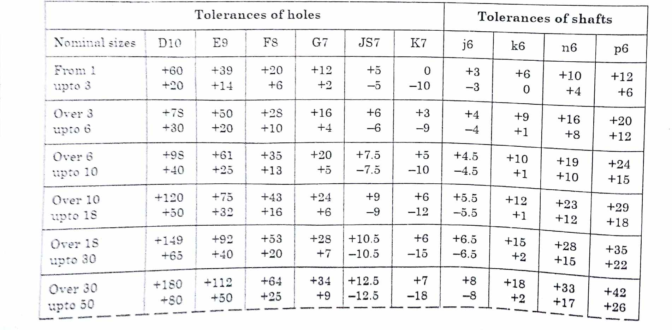

Slide 45
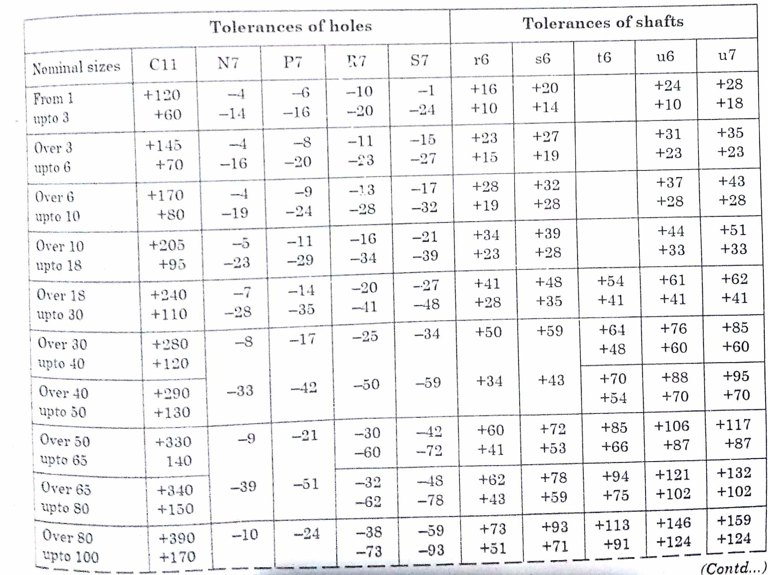

Slide 48
Datum feature: A datum feature is a feature of a part, such as an edge, surface, or a hole, which forms the basis for a datum or is used to establish its location.

Slide 49
Symbols representing the characteristics to be toleranced

Slide 51
MACHINING SYMBOLS

Slide 52
INDICATION OF MACHINING ALLOWANCE

Slide 53
SUFACE ROUGHNESS VALUES EXPECTED FROM MANUFACTURING PROCESSES

Slide 55
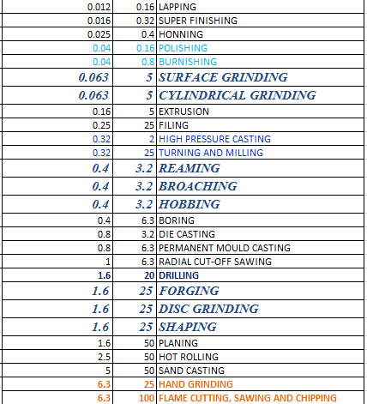

Slide 57
